Slide 1

Transforming Trends into Engaging Content Ideas
Presented by:
ASUTOSH KUMAR: 2205016
BAISHNABI SAHOO: 2205018
BIJAYRAJ PARIJA: 2205023

Slide 2


AI-Powered YouTube Idea Generator
A sophisticated three-tier application that combines Google Trends, YouTube data, and AI to generate engaging video content ideas tailored to your audience.

Slide 3
Frontend Layer
Streamlit-based UI (app.py)provides intuitive user interface for topic input and result display.
System Architecture Overview
Utility Modules
Specialised modules handle Google Trends and YouTube data retrieval independently.
Backend Orchestrator
FastAPI server (main.py) coordinates all operations and manages external API communications.

Slide 4
The Frontend: User Interface
Built with Streamlit
Key Components
The app.py file creates an interactive web interface where users enter their topic, select target audience, and specify region.
st.title() for main heading
st.text_input() for topic entry
st.selectbox() for audience selection
requests.get() for API communication
Error handling for failed requests
When users click "Generate", it packages data and sends HTTP GET requests to the backend API using the requests library.

Slide 5
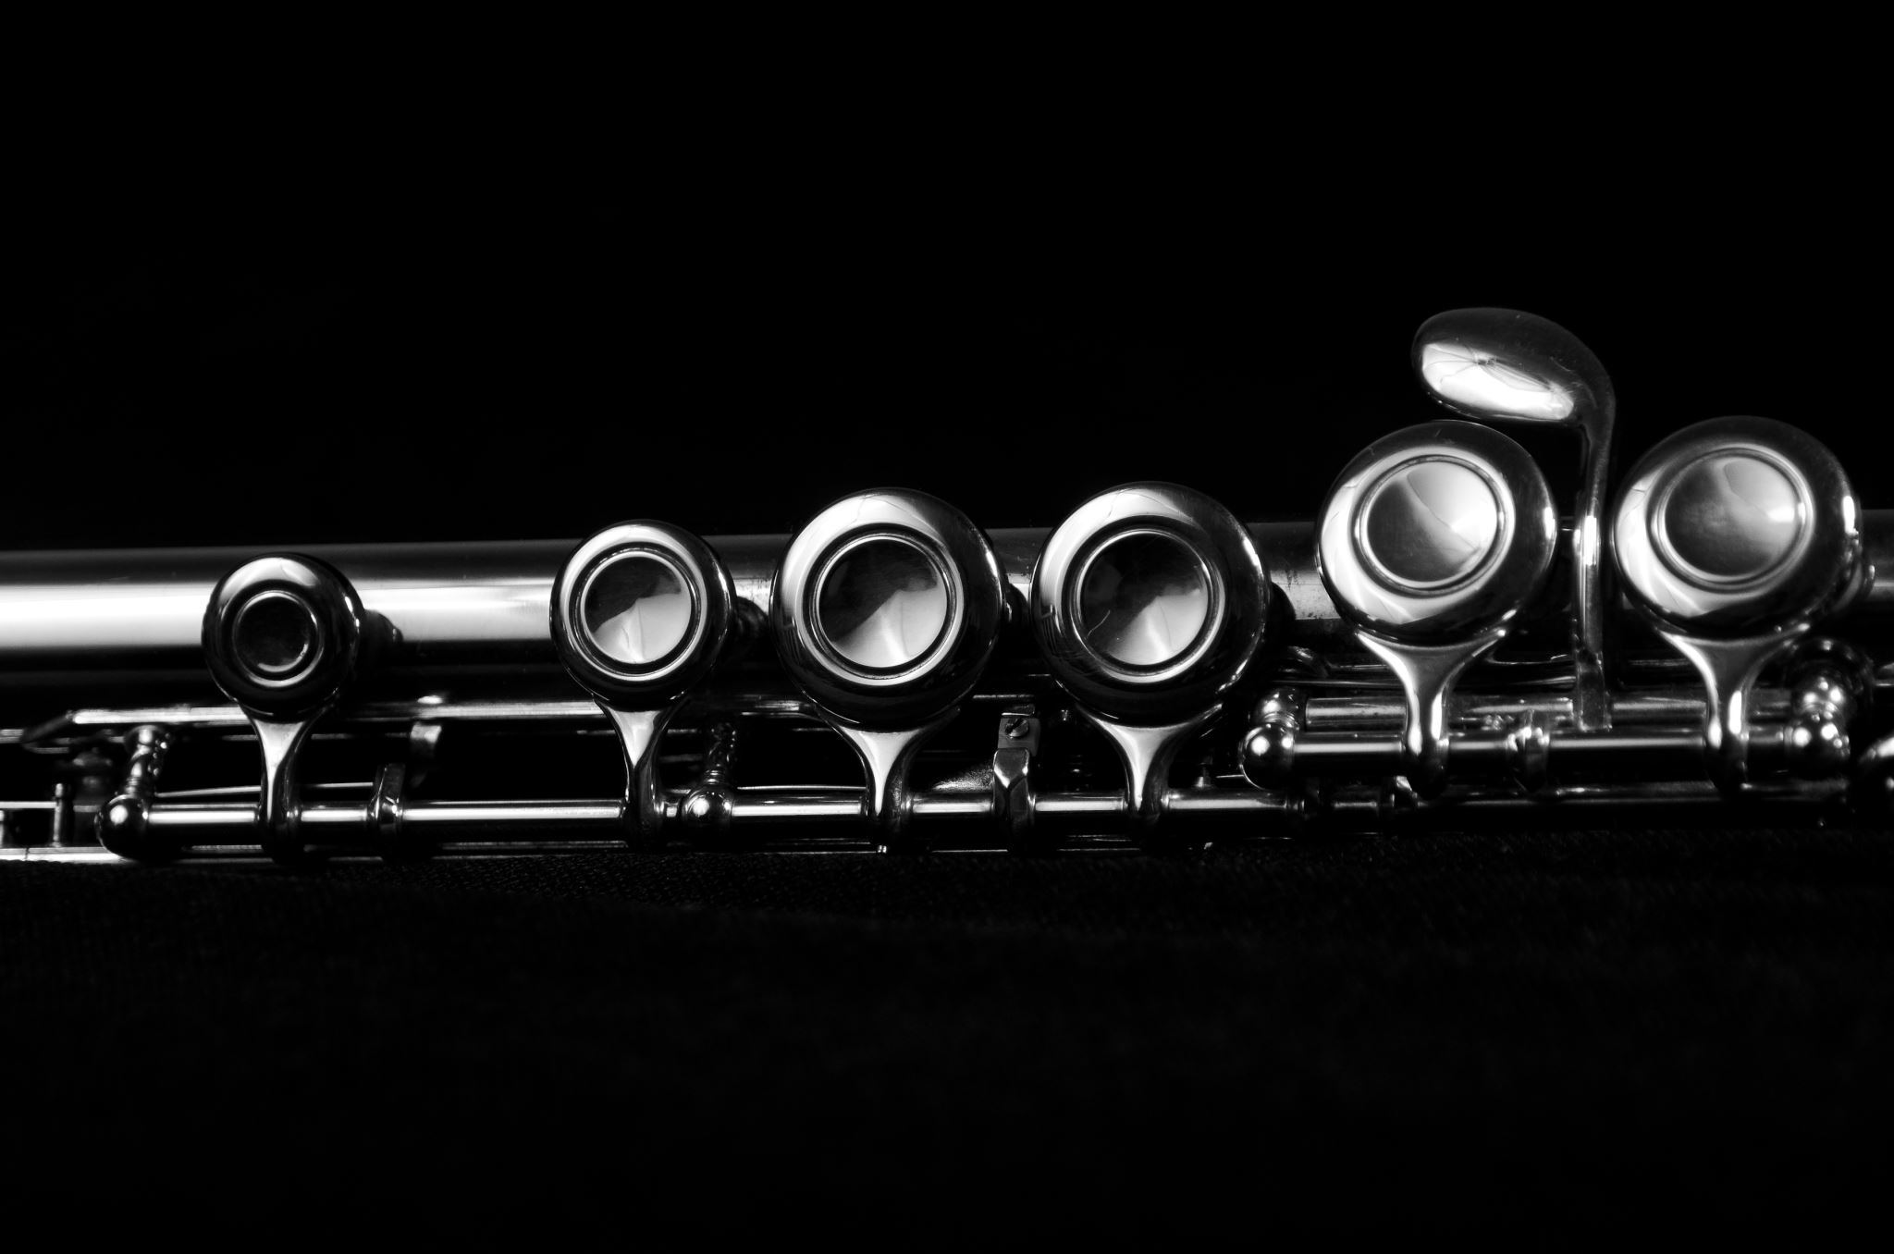
Backend Orchestration
01
02
03
Receive Request
Aggregate Data
Prompt Engineering
FastAPI endpoint accepts topic, audience, and region parameters from frontend client.
Calls utility modules to fetch trending keywords and popular YouTube videos.
Combines gathered data into rich, contextual prompt for AI service.
04
05
AI Generation
Return Response
Sends POST request to EURI API with engineered prompt and receives ideas.
Packages keywords, videos, and AI ideas into single JSON response for frontend.

Slide 6

Google Trends Integration
Keyword Discovery
The google_trends.py module interfaces with SerpApi to fetch related search queries from Google Trends.
It filters results for the last 12 months, extracts top 10 related queries, and applies custom AI-relevance filtering.
Uses python-dotenv to securely manage SERPAPI_KEY from environment variables.

Slide 7
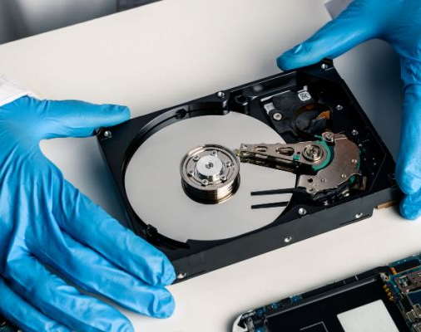
YouTube Data Retrieval
API Configuration
Connects to official YouTube Data API v3 with secure authentication using
YOUTUBE_API_KEY.
Search Parameters
Queries videos by topic and region, ordering results by viewCount to
identify trending content.
Data Transformation
Parses JSON response, extracts titles, and constructs full YouTube URLs from
videoId.
Clean Output
Returns formatted list of dictionaries containing video titles and clickable URLs.

Slide 8
Security & Best Practices
Environment Variables
Startup Validation
All API keys stored in .env file, loaded via python-dotenv, never hardcoded in source.
Application checks for required API keys on startup, failing fast if credentials missing.
Error Handling
Separation of Concerns
Comprehensive try-except blocks catch network failures and API errors gracefully.
Modular architecture isolates frontend, backend orchestration, and utility functions.

Slide 9

Data Flow Journey
User Input
User enters topic, audience, and region in Streamlit interface.
Frontend Request
Streamlit sends GET request with parameters to FastAPI backend.
Data Gathering
Backend calls utility modules to fetch trends and videos from external APIs.
AI Processing
Engineered prompt sent to EURI API, generating contextual video ideas.
Response Delivery
Complete JSON response returned to frontend for user display.

Slide 10
Key Technologies & Libraries
Streamlit
Requests
Rapid UI development for data applications with minimal code.
Elegant HTTP library for seamless API communication and data exchange.
FastAPI
Python-dotenv
Modern, fast web framework for building APIs with automatic documentation.
Secure credential management through environment variable loading.
This modular, secure architecture demonstrates professional software engineering practices with clear separation of concerns, robust error handling, and scalable design patterns.

Slide 11

REFERENCES
This project used several key technologies, external APIs, and Python libraries. Below are the main references and their documentation links:
Project Codebase
- GitHub Repository: [https://github.com/Ashutoshkr2154/youtube_videos_idea_generator](https://github.com/Ashutoshkr2154/youtube_videos_idea_generator)
Core Technologies
- FastAPI – High-performance web framework for APIs.
Docs: [https://fastapi.tiangolo.com/](https://fastapi.tiangolo.com/)
- Streamlit – Framework for building data/ML web apps.
Docs: [https://streamlit.io/](https://streamlit.io/)
- Uvicorn – ASGI server for running FastAPI apps.
Docs: [https://www.uvicorn.org/](https://www.uvicorn.org/)
- Python-dotenv – Loads environment variables from `.env` files.
PyPI: [https://pypi.org/project/python-dotenv/](https://pypi.org/project/python-dotenv/)
External APIs
- Google YouTube Data API v3 – Used for video search and trend analysis.
Docs: [https://developers.google.com/youtube/v3/docs](https://developers.google.com/youtube/v3/docs)
- SerpApi – Used to fetch Google Trends “Related Queries” data.
Website: [https://serpapi.com/](https://serpapi.com/)

Slide 12

CONCLUSION
The AI-Powered YouTube Idea Generator is a robust, modular application designed to transform trending data into engaging video content ideas. It integrates Google Trends, YouTube Data API, and AI services through a well-architected system comprising:
A Streamlit-based frontend for intuitive user interaction.
A FastAPI backend that orchestrates data flow and API communication.
Utility modules that independently handle keyword discovery and video retrieval.
The system ensures security and scalability through best practices like environment variable management, error handling, and separation of concerns. By leveraging prompt engineering and contextual data aggregation, the tool delivers tailored video ideas that align with audience interests and regional trends.
This architecture exemplifies modern software engineering principles, offering a scalable and secure solution for content creators seeking data-driven inspiration.

